Slide 1
Chapter 6: Link Analysis

Slide 2
Road map
Introduction
Social network analysis
Co-citation and bibliographic coupling
PageRank
HITS
Summary
CS583, Bing Liu, UIC

Slide 3
Introduction
Early search engines mainly compare content similarity of the query and the indexed pages. I.e.,
  They use information retrieval methods, cosine, TF-IDF, ...
From 1996, it became clear that content similarity alone was no longer sufficient.
  The number of pages grew rapidly in the mid-late 1990’s.
    Try “classification technique”, Google estimates: 10 million relevant pages.
    How to choose only 30-40 pages and rank them suitably to present to the user?
  Content similarity is easily spammed.
    A page owner can repeat some words and add many related words to boost the rankings of his pages and/or to make the pages relevant to a large number of queries.
CS583, Bing Liu, UIC

Slide 4
Introduction (cont …)
Starting around 1996, researchers began to work on the problem. They resort to hyperlinks.
  In Feb, 1997, Yanhong Li (Robin Li), Scotch Plains, NJ, filed a hyperlink based search patent. The method uses words in anchor text of hyperlinks.
Web pages on the other hand are connected through hyperlinks, which carry important information.
  Some hyperlinks: organize information at the same site.
  Other hyperlinks: point to pages from other Web sites. Such out-going hyperlinks often indicate an implicit conveyance of authority to the pages being pointed to.
Those pages that are pointed to by many other pages are likely to contain authoritative information.
CS583, Bing Liu, UIC

Slide 5
Introduction (cont …)
During 1997-1998, two most influential hyperlink based search algorithms PageRank and HITS were reported.
Both algorithms are related to social networks. They exploit the hyperlinks of the Web to rank pages according to their levels of “prestige” or “authority”.
  HITS: Jon Kleinberg (Cornel University), at Ninth Annual ACM-SIAM Symposium on Discrete Algorithms, January 1998
  PageRank: Sergey Brin and Larry Page, PhD students from Stanford University, at Seventh International World Wide Web Conference (WWW7) in April, 1998.
PageRank powers the Google search engine.
CS583, Bing Liu, UIC

Slide 6
Introduction (cont …)
Apart from search ranking, hyperlinks are also useful for finding Web communities.
  A Web community is a cluster of densely linked pages representing a group of people with a special interest.
Beyond explicit hyperlinks on the Web, links in other contexts are useful too, e.g.,
  for discovering communities of named entities (e.g., people and organizations) in free text documents, and
  for analyzing social phenomena in emails..
CS583, Bing Liu, UIC

Slide 7
Road map
Introduction
Social network analysis
Co-citation and bibliographic coupling
PageRank
HITS
Summary
CS583, Bing Liu, UIC

Slide 8
Social network analysis
Social network is the study of social entities (people in an organization, called actors), and their interactions and relationships.
The interactions and relationships can be represented with a network or graph,
  each vertex (or node) represents an actor and
  each link represents a relationship.
From the network, we can study the properties of its structure, and the role, position and prestige of each social actor.
We can also find various kinds of sub-graphs, e.g., communities formed by groups of actors.
CS583, Bing Liu, UIC

Slide 9
Social network and the Web
Social network analysis is useful for the Web because the Web is essentially a virtual society, and thus a virtual social network,
  Each page: a social actor and
  each hyperlink: a relationship.
Many results from social network can be adapted and extended for use in the Web context.
We study two types of social network analysis, centrality and prestige, which are closely related to hyperlink analysis and search on the Web.
CS583, Bing Liu, UIC

Slide 10
Centrality
Important or prominent actors are those that are linked or involved with other actors extensively.
A person with extensive contacts (links) or communications with many other people in the organization is considered more important than a person with relatively fewer contacts.
The links can also be called ties. A central actor is one involved in many ties.
CS583, Bing Liu, UIC

Slide 11
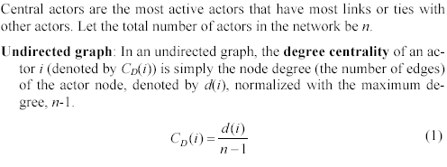
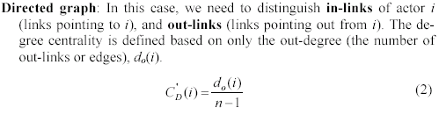
Degree Centrality
CS583, Bing Liu, UIC

Slide 12
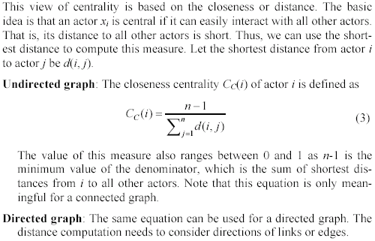
Closeness Centrality
CS583, Bing Liu, UIC

Slide 13
Betweenness Centrality
If two non-adjacent actors j and k want to interact and actor i is on the path between j and k, then i may have some control over the interactions between j and k.
Betweenness measures this control of i over other pairs of actors. Thus,
  if i is on the paths of many such interactions, then i is an important actor.
CS583, Bing Liu, UIC

Slide 14
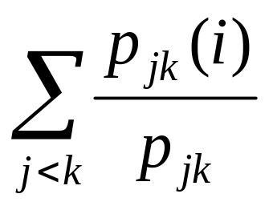
Betweenness Centrality (cont …)
Undirected graph: Let p_{jk} be the number of shortest paths between actor j and actor k.
The betweenness of an actor i is defined as the number of shortest paths that pass i (p_{jk}(i)) normalized by the total number of shortest paths.
(4)
CS583, Bing Liu, UIC

Slide 15
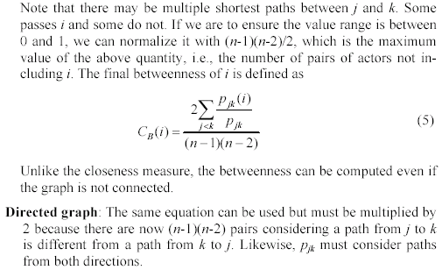
Betweenness Centrality (cont …)
CS583, Bing Liu, UIC

Slide 16
Prestige
Prestige is a more refined measure of prominence of an actor than centrality.
  Distinguish: ties sent (out-links) and ties received (in-links).
A prestigious actor is one who is object of extensive ties as a recipient.
  To compute the prestige: we use only in-links.
Difference between centrality and prestige:
  centrality focuses on out-links
  prestige focuses on in-links.
We study three prestige measures. Rank prestige forms the basis of most Web page link analysis algorithms, including PageRank and HITS.
CS583, Bing Liu, UIC

Slide 17

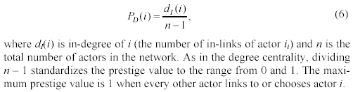
Degree prestige
CS583, Bing Liu, UIC

Slide 18
Proximity prestige
The degree index of prestige of an actor i only considers the actors that are adjacent to i.
The proximity prestige generalizes it by considering both the actors directly and indirectly linked to actor i.
  We consider every actor j that can reach i.
Let I_{i} be the set of actors that can reach actor i.
The proximity is defined as closeness or distance of other actors to i.
Let d(j, i) denote the distance from actor j to actor i.
CS583, Bing Liu, UIC

Slide 19
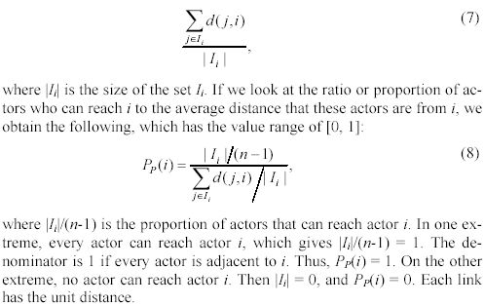
Proximity prestige (cont …)
Average distance=
CS583, Bing Liu, UIC

Slide 20
Rank prestige
In the previous two prestige measures, an important factor is considered,
  the prominence of individual actors who do the “voting”
In the real world, a person i chosen by an important person is more prestigious than chosen by a less important person.
  For example, if a company CEO votes for a person is much more important than a worker votes for the person.
If one’s circle of influence is full of prestigious actors, then one’s own prestige is also high.
  Thus one’s prestige is affected by the ranks or statuses of the involved actors.
CS583, Bing Liu, UIC

Slide 21
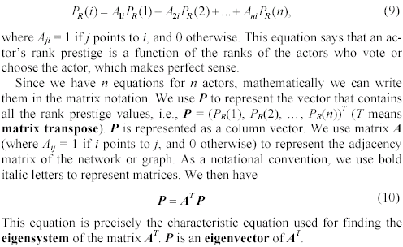
Rank prestige (cont …)
Based on this intuition, the rank prestige P_{R}(i) is define as a linear combination of links that point to i:
CS583, Bing Liu, UIC

Slide 22
Road map
Introduction
Social network analysis
Co-citation and bibliographic coupling
PageRank
HITS
Summary
CS583, Bing Liu, UIC

Slide 23
Co-citation and Bibliographic Coupling
Another area of research concerned with links is citation analysis of scholarly publications.
  A scholarly publication cites related prior work to acknowledge the origins of some ideas and to compare the new proposal with existing work.
When a paper cites another paper, a relationship is established between the publications.
  Citation analysis uses these relationships (links) to perform various types of analysis.
We discuss two types of citation analysis, co-citation and bibliographic coupling. The HITS algorithm is related to these two types of analysis.
CS583, Bing Liu, UIC

Slide 24
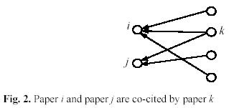
Co-citation
If papers i and j are both cited by paper k, then they may be related in some sense to one another.
The more papers they are cited by, the stronger their relationship is.
CS583, Bing Liu, UIC

Slide 25
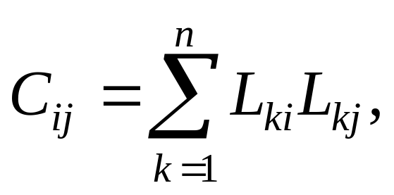
Co-citation
Let L be the citation matrix. Each cell of the matrix is defined as follows:
  L_{ij} = 1 if paper i cites paper j, and 0 otherwise.
Co-citation (denoted by C_{ij}) is a similarity measure defined as the number of papers that co-cite i and j,
C_{ii} is naturally the number of papers that cite i.
A square matrix C can be formed with C_{ij}, and it is called the co-citation matrix.
CS583, Bing Liu, UIC

Slide 26
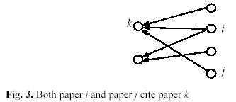
Bibliographic coupling
Bibliographic coupling operates on a similar principle.
Bibliographic coupling links papers that cite the same articles
  if papers i and j both cite paper k, they may be related.
The more papers they both cite, the stronger their similarity is.
CS583, Bing Liu, UIC

Slide 27
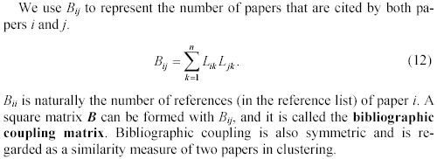
Bibliographic coupling (cont …)
CS583, Bing Liu, UIC

Slide 28
Road map
Introduction
Social network analysis
Co-citation and bibliographic coupling
PageRank
HITS
Summary
CS583, Bing Liu, UIC

Slide 29
PageRank
The year 1998 was an eventful year for Web link analysis models. Both the PageRank and HITS algorithms were reported in that year.
The connections between PageRank and HITS are quite striking.
Since that eventful year, PageRank has emerged as the dominant link analysis model,
  due to its query-independence,
  its ability to combat spamming, and
  Google’s huge business success.
CS583, Bing Liu, UIC

Slide 30
PageRank: the intuitive idea
PageRank relies on the democratic nature of the Web by using its vast link structure as an indicator of an individual page's value or quality.
PageRank interprets a hyperlink from page x to page y as a vote, by page x, for page y.
However, PageRank looks at more than the sheer number of votes; it also analyzes the page that casts the vote.
  Votes casted by “important” pages weigh more heavily and help to make other pages more "important."
This is exactly the idea of rank prestige in social network.
CS583, Bing Liu, UIC

Slide 31
More specifically
A hyperlink from a page to another page is an implicit conveyance of authority to the target page.
  The more in-links that a page i receives, the more prestige the page i has.
Pages that point to page i also have their own prestige scores.
  A page of a higher prestige pointing to i is more important than a page of a lower prestige pointing to i.
  In other words, a page is important if it is pointed to by other important pages.
CS583, Bing Liu, UIC

Slide 32
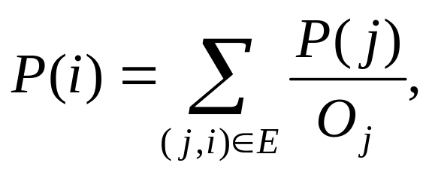
PageRank algorithm
According to rank prestige, the importance of page i (i’s PageRank score) is the sum of the PageRank scores of all pages that point to i.
Since a page may point to many other pages, its prestige score should be shared.
The Web as a directed graph G = (V, E). Let the total number of pages be n. The PageRank score of the page i (denoted by P(i)) is defined by:
O_{j} is the number of out-link of j
CS583, Bing Liu, UIC

Slide 33
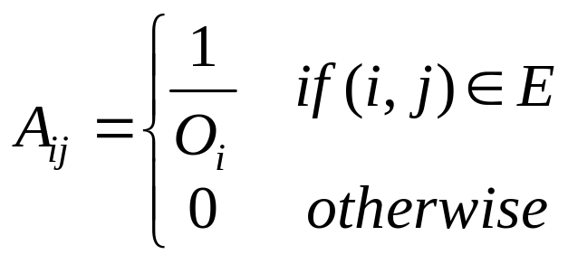
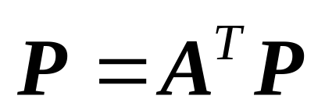
Matrix notation
We have a system of n linear equations with n unknowns. We can use a matrix to represent them.
Let P be a n-dimensional column vector of PageRank values, i.e., P = (P(1), P(2), …, P(n))^{T}.
Let A be the adjacency matrix of our graph with
We can write the n equations with (PageRank)
(14)
(15)
CS583, Bing Liu, UIC

Slide 34
Road map
Introduction
Social network analysis
Co-citation and bibliographic coupling
PageRank
HITS
Summary
CS583, Bing Liu, UIC

Slide 35
HITS
HITS stands for Hypertext Induced Topic Search.
Unlike PageRank which is a static ranking algorithm, HITS is search query dependent.
When the user issues a search query,
  HITS first expands the list of relevant pages returned by a search engine and
  then produces two rankings of the expanded set of pages, authority ranking and hub ranking.
CS583, Bing Liu, UIC

Slide 36
Authorities and Hubs
Authority: Roughly, a authority is a page with many in-links.
  The idea is that the page may have good or authoritative content on some topic and
  thus many people trust it and link to it.
Hub: A hub is a page with many out-links.
  The page serves as an organizer of the information on a particular topic and
  points to many good authority pages on the topic.
CS583, Bing Liu, UIC

Slide 37
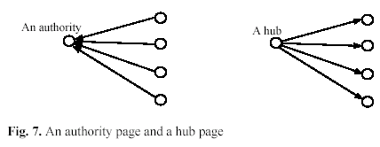
Examples
CS583, Bing Liu, UIC

Slide 38
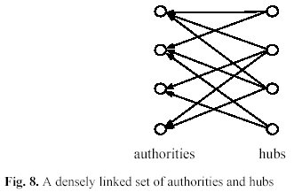
The key idea of HITS
A good hub points to many good authorities, and
A good authority is pointed to by many good hubs.
Authorities and hubs have a mutual reinforcement relationship. Fig. 8 shows some densely linked authorities and hubs (a bipartite sub-graph).
CS583, Bing Liu, UIC

Slide 39
The HITS algorithm: Grab pages
Given a broad search query, q, HITS collects a set of pages as follows:
  It sends the query q to a search engine.
  It then collects t (t = 200 is used in the HITS paper) highest ranked pages. This set is called the root set W.
  It then grows W by including any page pointed to by a page in W and any page that points to a page in W. This gives a larger set S, base set.
CS583, Bing Liu, UIC

Slide 40
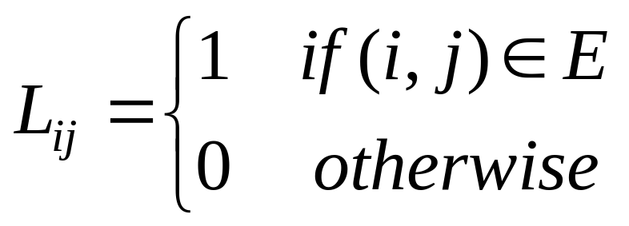
The link graph G
HITS works on the pages in S, and assigns every page in S an authority score and a hub score.
Let the number of pages in S be n.
We again use G = (V, E) to denote the hyperlink graph of S.
We use L to denote the adjacency matrix of the graph.
CS583, Bing Liu, UIC

Slide 41
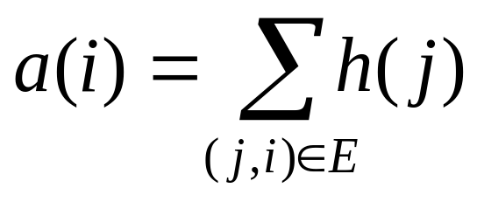
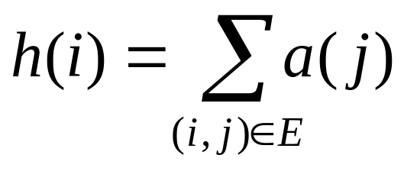
The HITS algorithm
Let the authority score of the page i be a(i), and the hub score of page i be h(i).
The mutual reinforcing relationship of the two scores is represented as follows:
(31)
(32)
CS583, Bing Liu, UIC

Slide 42
HITS in matrix form
We use a to denote the column vector with all the authority scores,
a = (a(1), a(2), …, a(n))^{T}, and
use h to denote the column vector with all the authority scores,
h = (h(1), h(2), …, h(n))^{T},
Then,
a = L^{T}h
h = La
(33)
(34)
CS583, Bing Liu, UIC

